Slide 1
Recitation 1
Developer Tools - Vim, Vscode, Makefile

Slide 2
Developer Tools

Slide 3
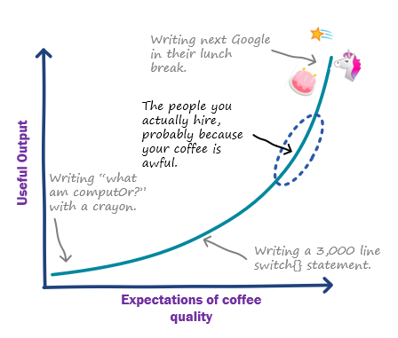
Developer tools
Vscode is technically a text editor but can be used as IDE
Text Editor | Emacs, Nano, Notepad, Vim
IDE | Vscode, Clion, Visual Studio
Compilers | GCC
Project Builder | Makefile, CMake
Computer Interfaces | GUI, Shell
Useful Tools we recommend
Using tools optimally will save a lot of time - Especially IDE, Project Builder & Shell
Scripts can be useful for creating tests

Slide 4
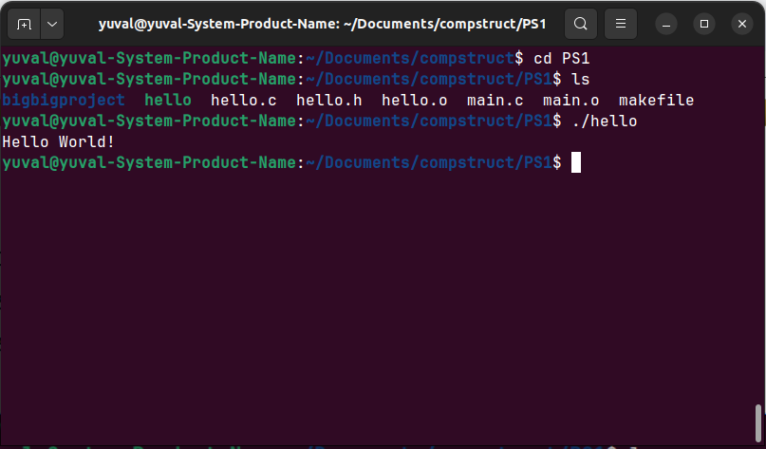
Shell
Computer program that exposes operating system services to user
Interprets commands and runs them

Slide 5
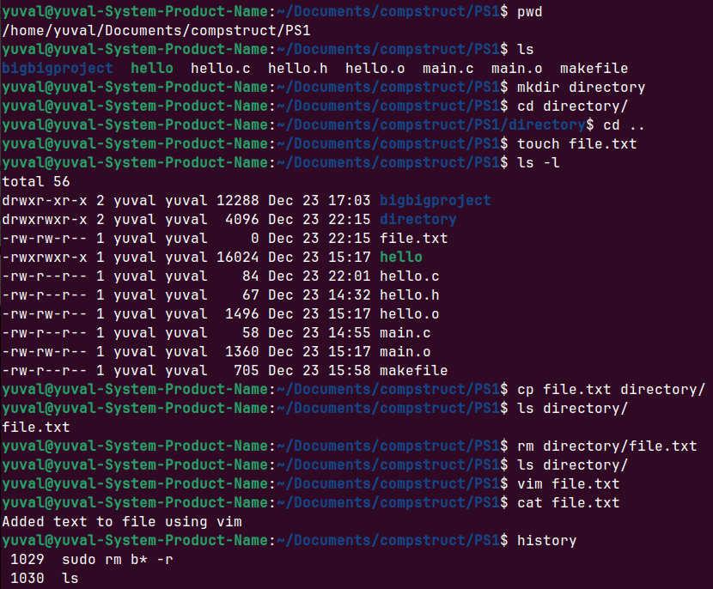
Shell - Basic Utilities
Utility - Program that may be run on Shell to receive some service (usually from OS)
pwd - present working directory
ls - list directory
mkdir - make directory
cd - change directory
cd .. for parent directory
cd ~ for home directory
touch - create new empty file
cp - copy file
rm - remove files/directories
mv - move files/directories
cat - concatenate file (prints file content)
man <command> - displays command manual
history - display used commands

Slide 6
Example Usage

Slide 7

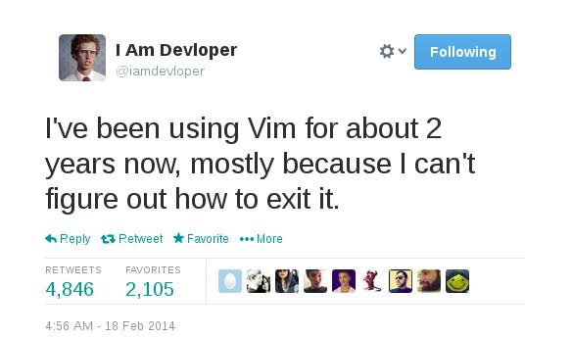
Vim
Based on text editor Vi
Vim - Vi improved
Highly configurable & powerful text editor
Vim’s guiding principle is Efficiency & speed
Modal editing - Operates in different Modes like: normal, insert, command…
Steep learning curve
Keyboard-Centric Navigation
Lightweight & Low resource consumption
High availability
Many Linux distributions come with vim

Slide 8
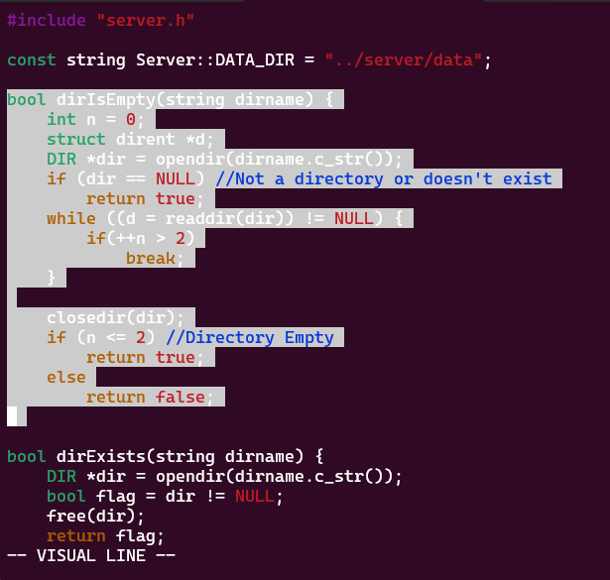
Vim Modes
איך הגעתי לכאן?
Visual Mode
Normal Mode
Default mode when opening Vim
Used for navigation & editing
Insert Mode
Insert text into document
Similar to behaviour in regular text editor
Visual Mode
Selecting and manipulating text blocks
Highlight portions of text to copy, paste, cut or apply formatting
Command Mode
Enter commands which affect file or editor itself
Actions such as saving files are done here
And more…

Slide 9
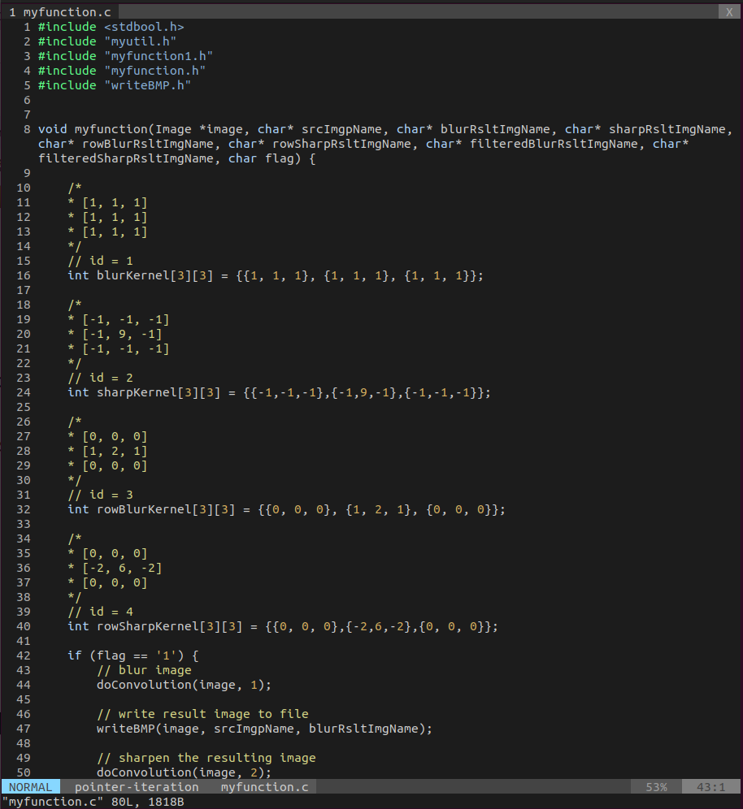
Vim - Config
Example Vim setup -
Installation Here
.vimrc - Configuration file
Set preferences, Define keybindings & more
Typically resides in User’s home directory
Plugins can be added
Enhance functionality
Created by Vim community
Enabled through .vimrc file
Directory of vim plugins - Vim Awesome

Slide 10
Example Usage

Slide 11
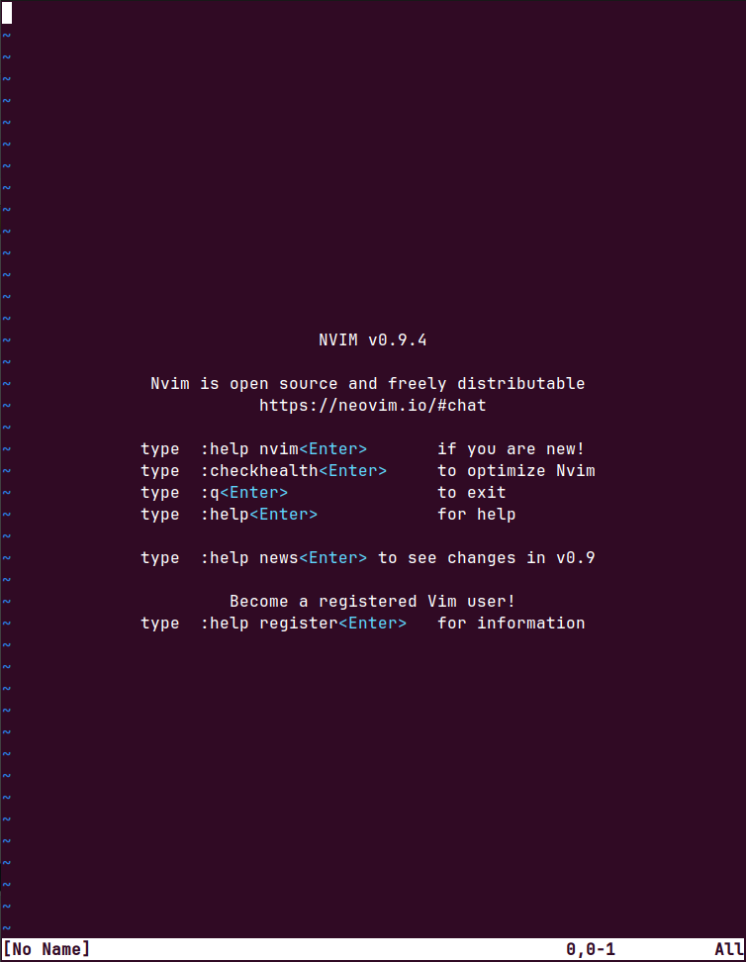
Neovim
Modernized and enhanced version of Vim
Community driven & more maintainable codebase
Modern features
Embedded terminal support
Better plugin handling
Enhanced Extensibility

Slide 12
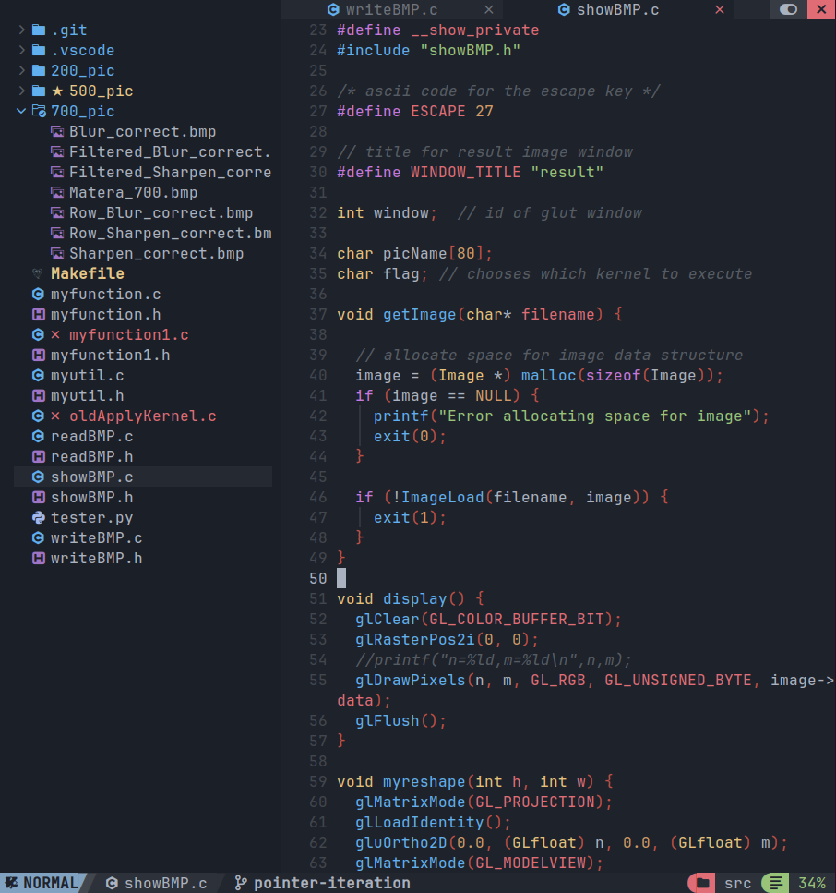
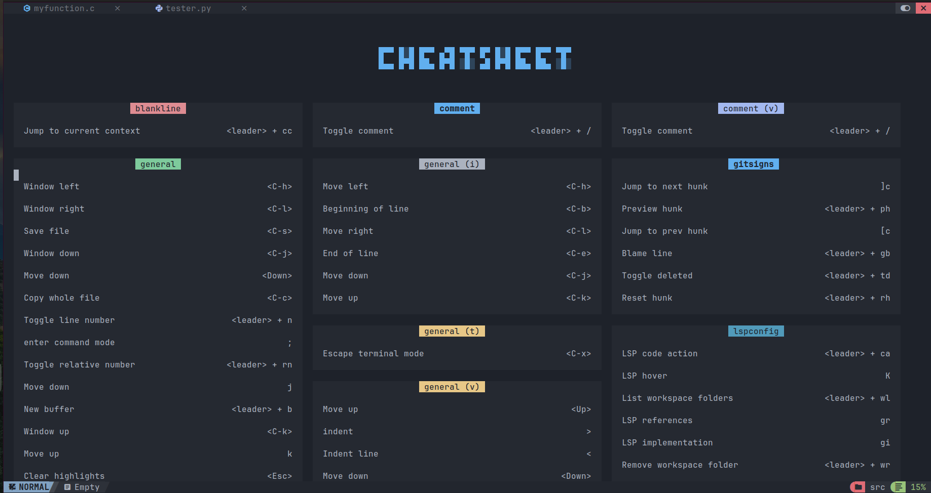
Neovim - Setup
Example setup named NvChad, to install. Adds Syntax Highlighting, Code completion, File explorer & much more.
Cheat Sheet to learn commands

Slide 13

VSCODE
Highly versatile and configurable
Modify settings through user-friendly interface or JSON files
Extension ecosystem
Contains vast extensions library
Enhances functionality, provides support for different programming languages and frameworks
Users tailor environment
Lightweight
Focus on core features, unlike most IDE’s which are usually an all-in-one package
Designed for flexibility and speed
Considered easy to use
Additional functionality can be added through extensions

Slide 14
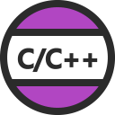
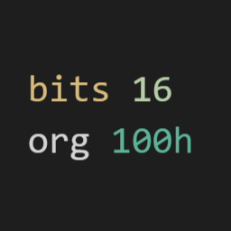

Recommended Extensions Language Support
Python
C/C++
X86 and x86_64 Assembly

Slide 15



Recommended Extensions Code completion
Intellicode
Code GPT: Chat & AI Agents
Copilot

Slide 16



Recommended Extensions Version Control & Productivity
Vim
Remote - SSH
Gitlens

Slide 17

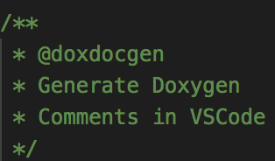

Recommended Extensions Quality of life
Material Icon Theme
Live Share
Doxygen Document Generator

Slide 18

Makefile
Make has great Documentation
Scripting language to automate process of building project
Ensures only modified files are rebuilt
Reduces unnecessary compilation
Allows extensive customization
Control over compiler flags (not trivial in IDE)
Widely used in C/C++ projects
We recommend also in assembly
Standardization
Allows Standard compilation process (independent of file names or project structure)

Slide 19
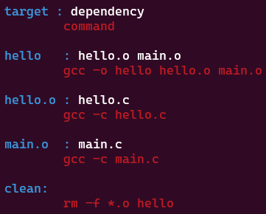

Makefile - How To
makefile
Target-Dependency rule structure
Each rule specifies how to generate target based on dependencies
Invoke “make” command to build project
“Make clean” to delete compilation files
rule:
Project

Slide 20
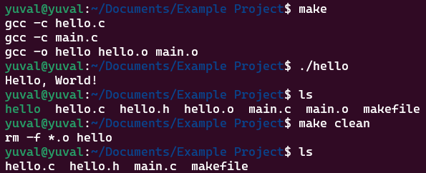
Makefile - How To
Dependency also called prerequisite & Command also called recipe
makefile
Target-Dependency rule structure
Each rule specifies how to generate target based on dependencies
Invoke “make” command to build project
“make clean” to delete compilation files
There can be multiple targets, dependencies & commands
rule:
Project

Slide 21
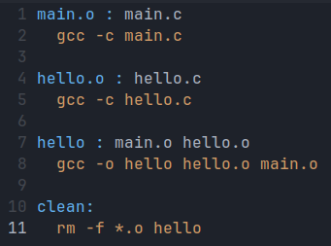
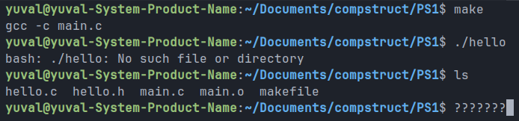
Makefile
If we switch rules makefile stops working, Why?
Looks like we only created the main.o file, Why?

Slide 22
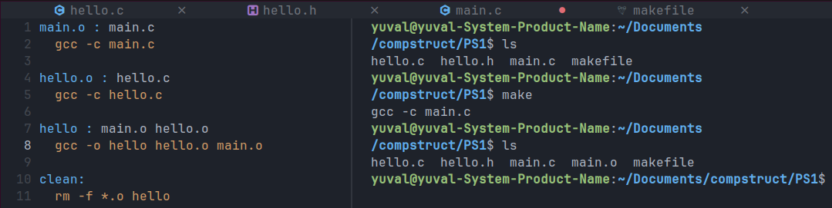
Makefile - Default Goal
The first target in the makefile is called the “Default Goal”
Goals are the targets make ultimately strives to update
If we want a certain file to be built, we need to make sure it’s the default goal or the default goal depends on it

Slide 23
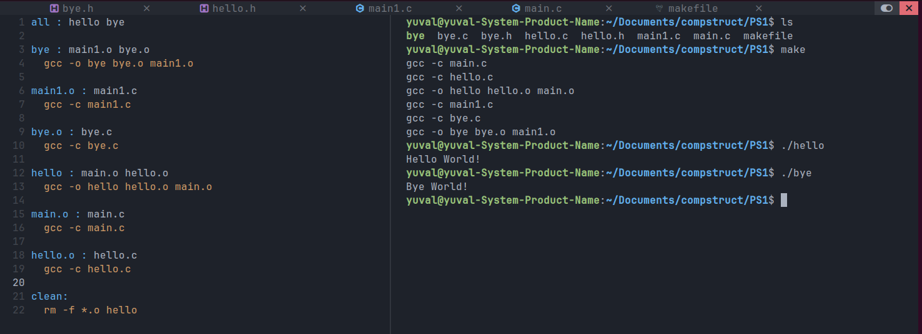
Makefile - Default Goal
We want to create two independent executables, hello & bye
All is a common practice target that is responsible for calling other targets

Slide 24
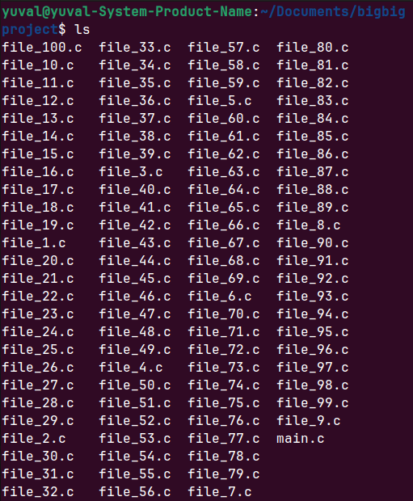
Makefile
What if our project contains too many files?
Solution: Using Variables, Wildcards & Patterns!
Manually creating the Makefile is a nightmare…

Slide 25
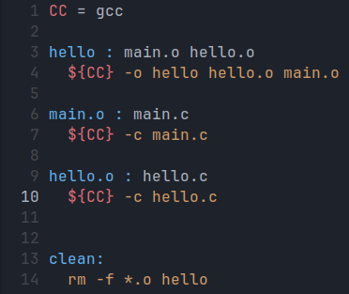
Makefile - Variables
Values in previous makefile are hardcoded
To fix this, we use variables
We use = or := to assign variables
CC := gcc - To set compiler
We use ${<var>} to reference variable
${CC} -c hello.c - is expanded to - gcc -c hello.c

Slide 26


Makefile - Automatic Variable
Special Variables automatically set to values
$@ - set to the filename of target
$< - set to the name of the first prerequisite
$^ - set to the name of all the prerequisites, with a space between each name

Slide 27
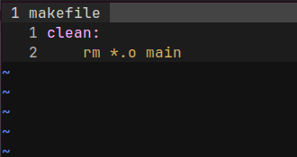
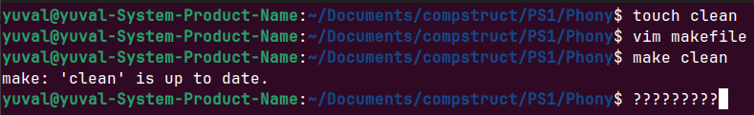
Makefile - Phony targets
A target which does not represent a file
If you write a rule whose recipe does not create the target file, then the recipe will be executed every time target comes up for remaking
If file does exists, calling rule will not work properly

Slide 28
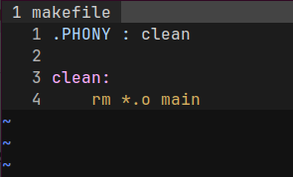
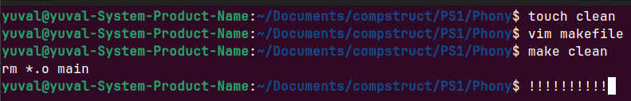
Makefile - Phony targets
Explicitly declare target as phony by making it a prerequisite to special target .PHONY

Slide 29
Example Usage

Slide 30
The end!

